Slide 1
Design of Software Systems CS 509
Fall 2022
Prof. George Heineman
WPI
heineman@cs.wpi.edu

Slide 2
OOA: Aggregation Relationship
Common collection relationship is 1 .. *
Signifies Peer relationship – neither one is more significant
But leads to gaps of understanding
Qualified Association
Reduces multiplicity using “keys”
Ensures that “same student doesn’t appear twice in course”
Shorthand for ensuring uniqueness within collection based upon marked attribute (id in this case)
Utility
Captures key-based semantics
Common in <Name, Value> lookups or databases

Slide 3
OOA: Aggregation Relationship
Aggregation
Denotes hierarchical relationship
Implied “1” over the white-diamond
Ask yourself: “Is there an operation that I would like to perform over all elements in the collection?”
Here: Compute “size” of directory by summing member File sizes
Composition
When an object cannot exist without a container object
Consider Polygon/PolygonLine example
No purpose in having PolygonLine object without enclosing Polygon
Optional (though useful) for PolygonLine to reference its “parent”

Slide 4
Most Important Analysis Technique
Identify responsibilities of a class
Store information? Define attributes
Provide functionality? Define methods
Sanity check each method
Does the class have enough information to meet its functional obligations?
If not, then you are missing attributes and relationships
During implementation you will ultimately discover various helper methods
Not necessary to spend time *now* to determine them all

Slide 5
Time to define methods for classes
Constructors
How to construct the objects
Pay attention to class relationships
How are players added to and removed from Game objects?
Is this needed functionality?
Option 1
Option 2
Option 3

Slide 6
Methods Describe Behaviors
Common Idioms
Collections / Sets / Bags that support dynamic add and remove
Set/Get methods
Do not include these ever on the OOAD
They will be assumed, and just clutter up space otherwise
Methods provide functionality
Look to use cases for inspiration
I will check for completeness by comparing use cases with classes
Constructors identify information known when constructing object initially
Not every attribute in the class belongs as a parameter to the constructor

Slide 7
Methods realize purpose of class
Each class has certain responsibilities
Data/structural responsibilities
A Model stores the Puzzle which stores Pieces which have information
Navigation lets you locate the information you want
At this early stage you can still identify capabilities that must exist. Consider Puzzle:
Need to know if a specific coordinate in puzzle is covered or not
isCovered(coord:Coordinate): boolean
Since it knows the selected piece, it can return a collection of potential moves (up, down, left or right)
availableMoves(): MoveType[*]

Slide 8
Subsystem structure
Boundary objects
Forms identified during Use Case Analysis
Controller objects
Manage uses cases
Initiated by actions on the boundary objects
Entity objects
Track persistent information
Note: NOT persistent objects
Key subsystems will likely have manager objects
Defines interface for system to use

Slide 9
Design Goals
Qualities that will be present
“Entity objects are not responsible for their own persistent storage”
Then must explain HOW info will persist
“Controllers responsible for requesting persistent changes”
Note the shift away from WHAT to HOW
Persistent Layer

Slide 10
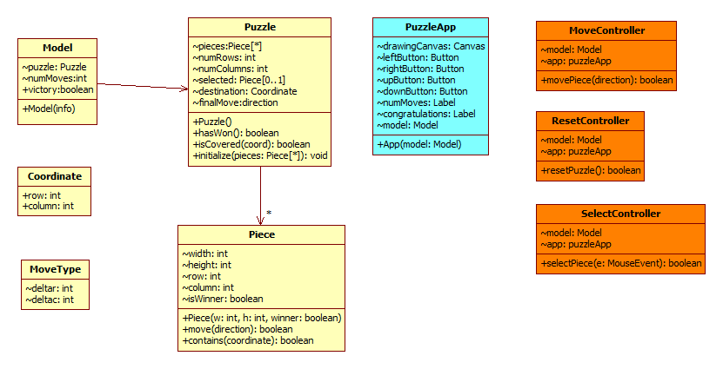
Full UML Presentation For Sliding Puzzle

Slide 11
Requirements
Functional Requirement
An area of functionality the system must support
Independent of the realization of the system
Non-Functional Requirement
A user-visible constraint on the system
Evaluation criteria for final system
nFR
Usability Performance
Reliability Supportability
FR
Final System

Slide 12
System Design (Inventory)
Scalability
How many simultaneous customers/managers to support?
How many customers can search at the same time
Access & Security
Manages and Corporate need to be authenticated
Mobility
Mobile application front-end or desktop application?
Asynchronous Behaviors
Is a customer notified if the item they are looking at has sold out (push) or must they check each time (pull)
Persistence
Is there a record of every transaction in the system?

Slide 13
Design Alternatives (Inventory)
Dedicated Server
Run process on cs.wpi.edu:8500 for example
Specialized “Fat” Client Applications connect via TCP/IP
Maintain connection for entire session
Hardware / Operating System determines capacity
Storage
File system is limiting and ultimately will upgrade to database
Context
Too many simultaneous connections block clients from connecting
Fallback to backup servers (and tertiary backup servers…)
Use transactional ability (i.e., databases) to ensure consistency of calendar in face of simultaneous access
Deployment based on worst-case scenario

Slide 14
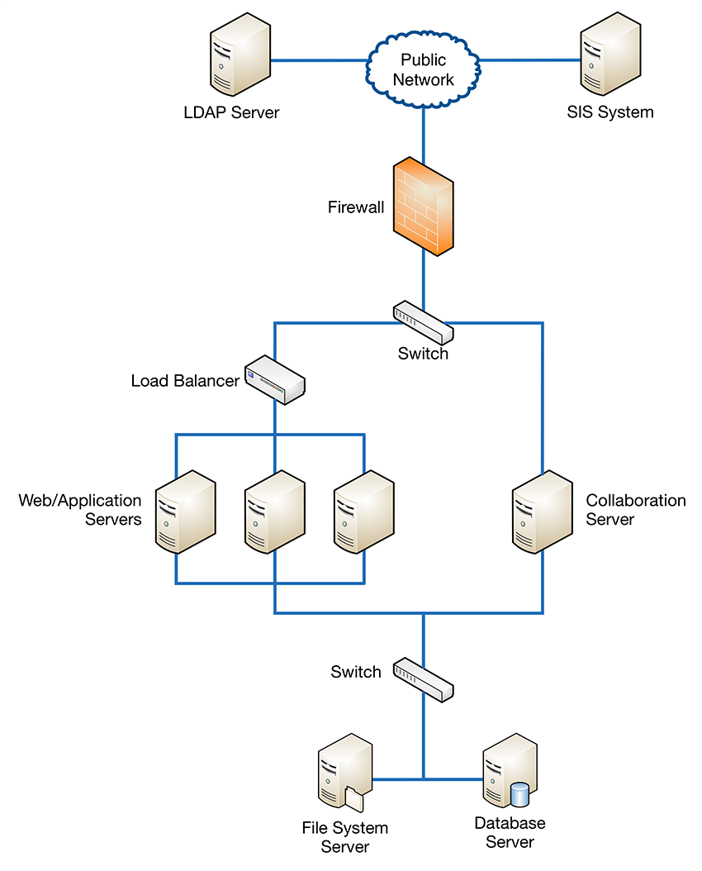
Design Alternatives (Inventory)
Web-based System
“Medium” Clients connect via HTTP/2 with no long-running sessions
RESTful communication (Representational State Transfer) with stateless protocol and standard operations
GET/PUT/POST
DELETE
Storage
Backend file system or database
Context
Load-balance
Web Server
Deployment can grow
Add more App Server hardware
Client-side uses standard API
https://help.blackboard.com/Learn/Administrator/Hosting/Performance_Optimization/Load_Balancing

Slide 15
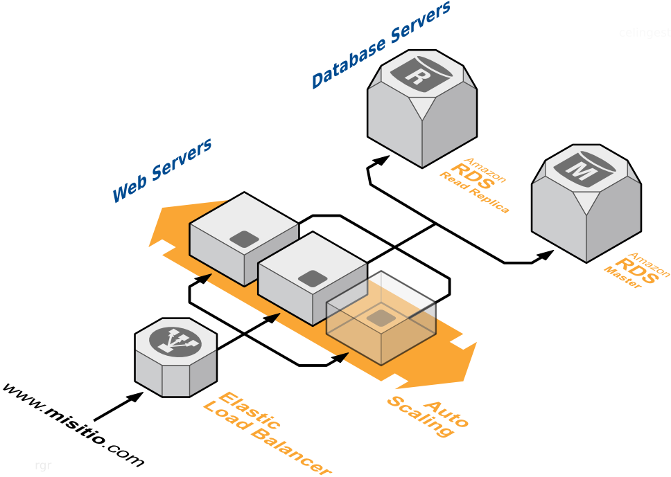
Design Alternatives (Inventory)
Cloud-based System
“Thin” Clients connect via HTTP/2 with no long-running sessions
Standard client-side interfaces
Backend
Now configured with server-side APIs
Storage
Backend database naturally fits
Context
Automatic load-balance
Web Server
Database Server
Deployment Can Grow based on demand
https://stackoverflow.com/questions/19200109/nginx-behind-load-balancers

Slide 16
Cloud-based Architecture
Essential difference is refactored responsibilities
AWS Cognito handles all authentication
Client-side presentation mix of HTML/CSS/JavaScript (thin)
Back-end storage
AWS S3 stores data and Jar files
Flexible data access
Computational storage
Virtual Private Cloud (VPC) (white paper)

Slide 17
High Level System Concerns
Storage Concerns
How is information to persist across application execution?
What is frequency of storage updates?
Consistency Concerns
How to ensure GUI reflects “consistent information”?
How to update GUI to show what is possible?

Slide 18
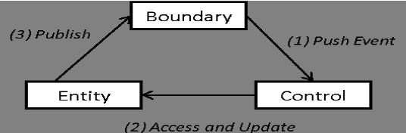
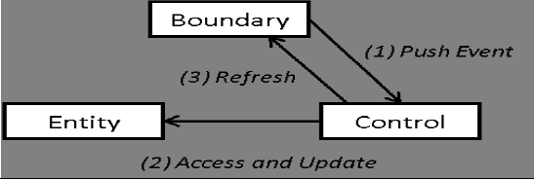
Entity Boundary Controller
Design Paradigm shows the macro structure of code
Demonstrates EBC structure
Review boundary classes for ‘actionable elements’
Review structure of entity classes (well, just Model)

Slide 19
Controller Structure
ComputeController
~app: App
~model: Model
+compute(): void
Name (derived from use case)
Attributes
Boundary over which it coordinates activities
Entities needed for its processing (might just be top-level Model)
Entry point
Compute method

Slide 20
Controller Objects → Functions
React examples
Local function within <App /> element
Delegate out to stand-alone function in Controller.js
export function selectPiece(model, canvas, event) {
…
}
Controller.js
const handleClick = (e) => {
let newModel = selectPiece(model, canvasRef.current, e);
setModel(newModel); // react to changes, if model has changed.
}
App.js
<canvas tabIndex="1" className="App-canvas“ ref={canvasRef}
width={layout.canvas.width} height={layout.canvas.height}
onClick={handleClick} />

Slide 21
Low-Level Behavior Of Controllers
Review Controllers
movePieceHandler
handleClick
Observe micro-behaviors
GUI entry point and invocation of controllers

Slide 22
Different Kinds Of Controllers Exist
Standard GUI controllers are called “Listeners” or “Handlers”
MouseListener (press, release, click, enter, exit)
MouseMotionListener (move, drag)
ActionListener (for buttons, menu items)
AdjustmentListener (for scrollbars)
KeyListener (for key events)
Multiple examples have all of these for you to review
Identify the existence of a controller class to handle a particular use case as initiated by an actor
Determine what entities it manipulates and make sure controller object can access entity objects
Determine what boundary it refreshes and make sure controller object can access boundary objects

Slide 23
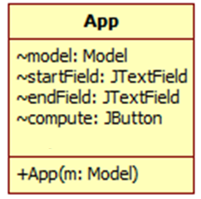
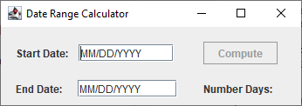
Boundary Design
Every actionable element in a GUI needs to be available in the interface
For every attribute X in a class it is assumed there is a getX() method
Do not include getX() or setX() methods in design diagram since it just clutters diagram

Slide 24
Controller Methods
Every controller needs an entry method
Pay attention to the parameter types
Don’t settle for GUI events, like actionPerformed or mousePress
You are writing the code after all…
Consider PuzzleController in GUI project
User clicks mouse on solved puzzle to randomize
User moves mouse to move piece
Doing multiple things, but at least related…
PuzzleController
~app: PuzzleApp
~model: Model
+mouseClicked(e: MouseEvent)
+mouseMoved(e: MouseEvent)

